Slide 1

BodyLogic
BL
Your Personal Health & Fitness AI Agent

Slide 2
Overview
1. Under Exercising
36% of UK adults do not meet exercise guidelines.
2. Excess Calories
Public Health England has estimated that adults in England are eating roughly 200–300 excess calories per day.
3. Unknown Intake
Surveys show that only about 20–35% of adults can correctly identify the recommended daily calorie intake.
“Imagine a friendly online coach that provides health advice on these topics using up to date, handpicked videos from Youtube…”
Welcome to BodyLogic.
BL

Slide 3
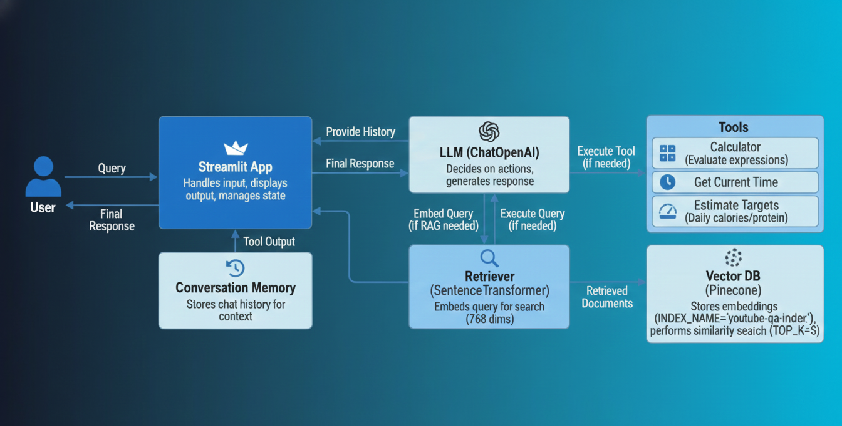
Technical Summary
Notes:
This is the BodyLogic RAG Agent with Tools and Conversational Memory query flow.
When a user submits a query, it's first enriched by Conversational Memory for context. The query then goes to an LLM (OpenAI's GPT), which decides if it needs to:
Retrieve Information (RAG): If knowledge base retrieval is needed, the query is embedded by a SentenceTransformer and used to fetch relevant documents from the Pinecone Vector Database (ensuring matching 768-dimension embeddings).
Use Tools: If the query requires specific actions like the estimator tool, the LLM intelligently calls one of the available tools.
The LLM then synthesizes information from the retrieved documents and tool outputs, and combines it with conversation history to provide a final, informed response back to the user through the Streamlit application.

Slide 4
Dataset and Processing
1. Data Selection and ingestion
The Data comes from expertly curated Youtube videos focusing on health and fitness.
The data processing uses the specialized YouTubeTranscriptApi library.
2. Processing
This broke it into overlapping chunks of about 500 characters with 50‑character overlap.
3. Vectorization
The processed data is converted into vectors and stored in the Pinecone Vector Database using the all-mpnet-base-v2 model - a good all round model for semantic search.

Slide 5
Q&A Agent
1. General Architecture
End-to-End Workflow:
4 -Step LangChain Runnable Chain
Core reasoning:
OpenAI's gpt-3.5-turbo
RAG Retrieval:
Uses a SentenceTransformer (all-mpnet-base-v2) to embed the user's query and retrieve context from the Vector Database
Tools:
The LLM can access and execute tools in the chain
2. Memory and Vector DB
Memory:
A global Python list stores the last 20 messages as conversation history.
Vector Database:
Pinecone
3. Prompt Template:
The System Message is the main prompt template, setting the agent's identity and providing strict instructions:
Persona: "friendly, evidence-based personal trainer and RAG assistant."
Goal: Give safe, practical fitness advice and explain reasoning clearly.
Contextual Rule: "Always use the retrieved knowledge base context when it is relevant."
Tool Use Rules: Contains explicit, mandatory rules for when to call each of the five custom tools (e.g., "you MUST call the estimate_targets tool" for macro queries).
Notes:
The Agent leverages a four-step LangChain Runnable Chain, OpenAI's gpt-3.5-turbo, a Pinecone Vector Database, and several custom tools to provide safe, practical fitness advice. The system incorporates a manual sliding window memory, a detailed prompt template, and is deployed using Streamlit with LangSmith tracing enabled for observability.

Slide 6
Tools
Database:
Pinecone
The knowledge base is built from the transcripts and content of selected YouTube videos.
The raw video content was processed (transcribed, chunked, and then converted into dense numerical vectors) using an embedding model sentence-transformers/all-mpnet-base-v2
A general-purpose model from the Hugging Face ecosystem, specifically designed for creating embeddings that capture the semantic meaning of text.
Tools:
Calorie and/or Macro Target Calculation.
The tool is engineered to estimate a user's target calorie and/or macronutrient intake.
It takes structured inputs (like age, weight, activity level) and returns a structured output (estimated calorie/macro numbers).
If a user Submits the query: "I am a 50 year old male 80kg what should be my calories targets be? “ The LLM decides to use the estimator tool and then gives back a friendly response to the user.

Slide 7
Evaluation
1. Qualitative Testing:
I used test “Demo Prompts" that serve as a basic test suite, covering RAG, tool use, and conversational memory to see if it was working as expected.
2. Traceability and Debugging:
LangSmith is used to log, visualize, and analyze every step of the LangChain RunnableSequence.
I used this to check if my tools were being called and then adjusted the system prompt when they were not.
3. Performance metrics
Performance metrics tracked in Langsmith such as the Latency and the tokens used.

Slide 8
Conclusion
BodyLogic makes expert fitness advice from videos accessible to those who prefer reading or quick answers over watching entire videos.
It enables efficient indexing and searching, and empowers you to instantly finds specific information from the expertly curated video knowledge on important health challenges many people face.
It gives safe, practical fitness advice, tailors suggestions to the user's level and goals, and clearly explains reasoning in simple language.
BL

Slide 9
Learning and Next steps
Further iterations of this could be:-
Improved memory
Deploy as an API endpoint using AWS App Runner and a custom front end.
Try different types of content in the Vector DB.
A Private RAG system with the Database and the User queries in a VPC.
A more efficient data ingestion system.

Slide 10
Dem
BL

